Slide 1
PLACEMENT MANAGEMENT SYSTEM
Developed By:
Pinal Dandgavhal
Unnati Kamble
Mokshda Kolte

Slide 2
INTRODUCTION
Job portals are sites where you can promote jobs and search for new jobs. They are an important part of almost every hiring procedure, and using them efficiently will interpret into qualified candidates for moderately low costs. So, below we have listed some benefits for both recruiters and job seekers for using job portals to find a job and promote job opening for the specific companies.
Job seekers can easily contact an extensive collection of job vacancies through job search engines, at their phase. Away from that, most job portals have filters which help users slight down results. This trait makes it easier for job seekers to decide on a specific career. Equally, online job search sites can help employers pace up their hiring process. It would be easy for recruiters or hiring managers to verify job applications online than physically scan printed resumes. Hence, job portals help them save time and endeavour.

Slide 3
Benefits of Using Job Portals for Job Seekers
Getting Job Alerts: A superior job portal provides standard job alerts whenever there are job openings for you. This way, you won’t neglect a chance to be valid for your target job and bound to start your career. Also, you can discover more posts to increase better options.
Classified:
Once you register in a job portal, all your achievements, skills, and individual details will be reserved privately. This will be kept secure unless you let them split your details to your future employers. Also, job portals keep your job search narration classified which permits you to do the task surreptitiously.
More job opportunities:
Job portals offer a full collection of job choices from top companies. It means you have a superior chance of searching the job you want anywhere and however; you want it.
Resourceful:
With these portals, you can be relevant for a job effortlessly. Instead of going to your intention firm, you can submit your resume online. After submitting, you can relax, and wait for your future employers to take action.

Slide 4
Benefits of Using Job Portals for Recruiters
Promote Firm’s Name:
Job portals give you a possibility to encourage your firm in a better beam. When a job seeker explores job opportunities, the first fixation they’ll ensure is your firm’s background. They’d want to know what sort of work culture, environment, and career development opportunities you have. With that, a job portal will give your firm an optimistic impression.
The easy way of choosing candidates:
As a recruiter, your aim is to fill your company with the most excellent people. Using a job portal in your hiring procedure makes it easier for you to choose the best applicant for the job. With this, you’ll have a record of applicants with your necessary skills, achievements, and experience.

Slide 5
Technology is Used:
Front end:
HTML,
CSS
BootStrap
Back end:
JAVA, MySQL

Slide 6
Softwares:
Spring tool suite
Eclipse IDE
MySql
JDK 1.8
Apache Tomcat 9
MySql Jconnector

Slide 7
Modules:
There are three modules in our project-:
Admin Module
JobSeeker Module
Recruiter Module

Slide 8
Admin Module:
Admin plays a very crucial role in the system. Admin can log in through a username and password. He/she can maintain the placement activities via the system. Admin can add company data, edit company details & delete company record. Admin is also able to view all the jobseeker information.

Slide 9
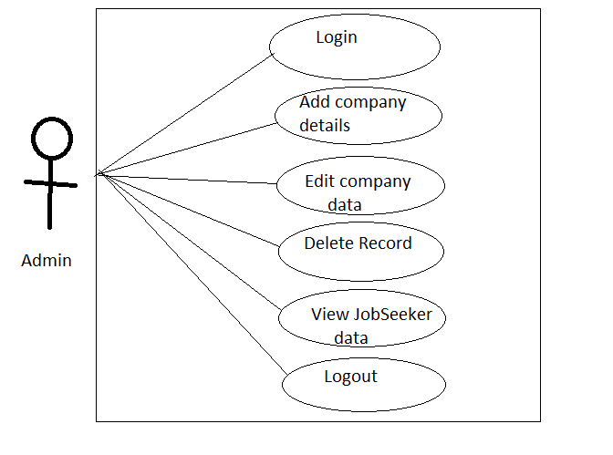
Use Case :

Slide 10
JobSeeker Module
A jobseeker or candidate is a person who is looking for a viable employment (job) opportunity. This placement system portal provides ample employment opportunities to these jobseekers. To get a job through the our portal as a jobseeker, you need to first register yourself on the portal. The registration allows you to search and apply for jobs on the portal.
The jobseeker module covers the following functionality.
Access the Application
Signup/Registration
Log in using username and password
View Jobs
Jobs Applied

Slide 11
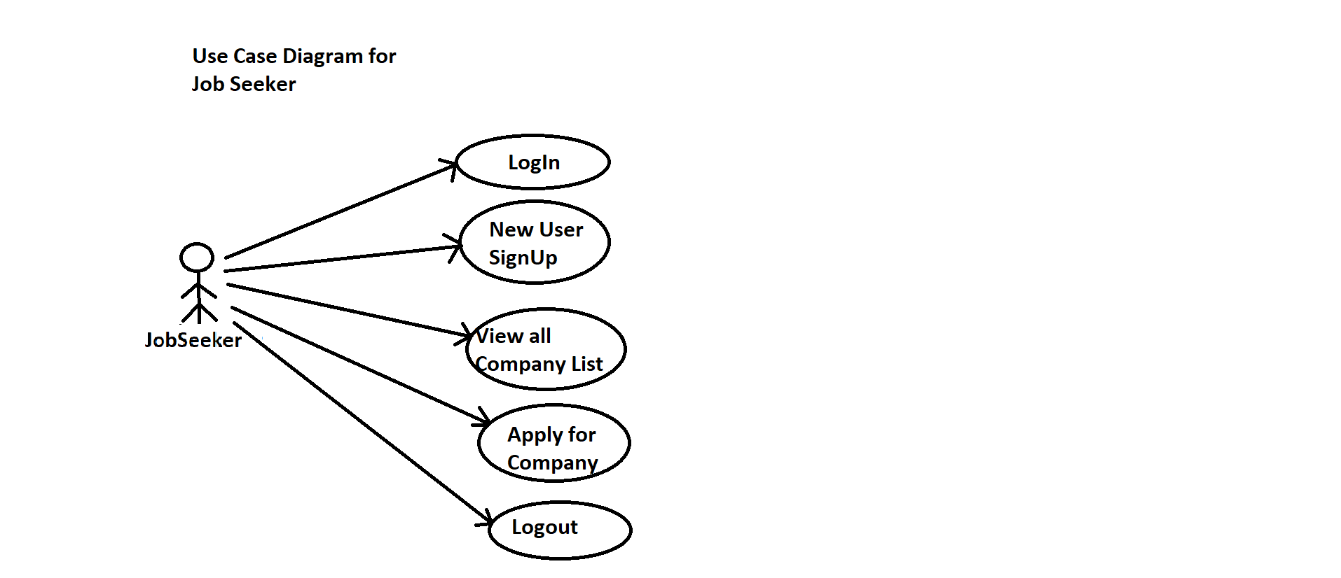
Use Case

Slide 12
Recruiter Module
In this module recruiter can login using username and password. and verifying the jobseekers details.
If jobseeker details is fit for the job role then interview will be scheduled for that jobseeker person. If it is not match with company requirements then application will be rejected

Slide 13
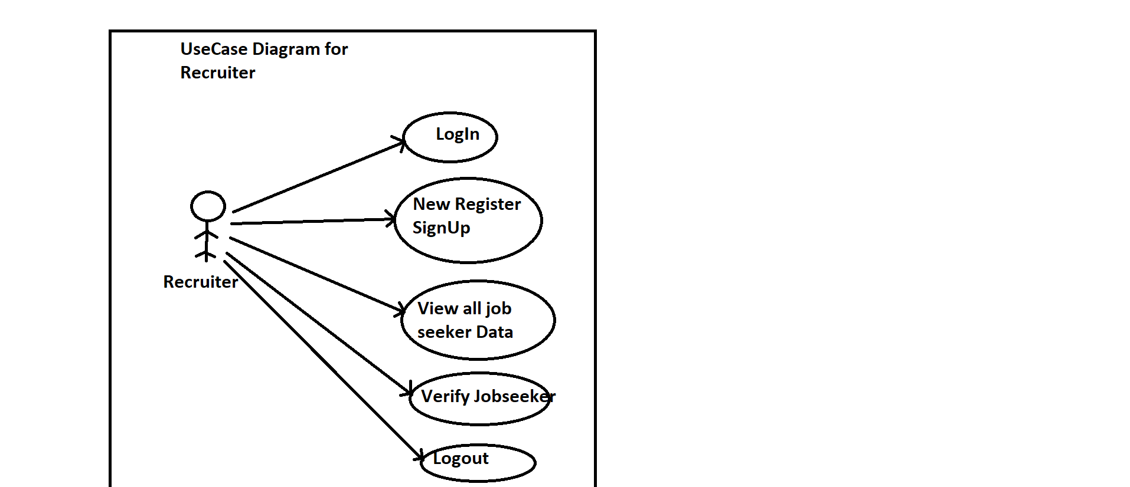
Use Case Diagram

Slide 14
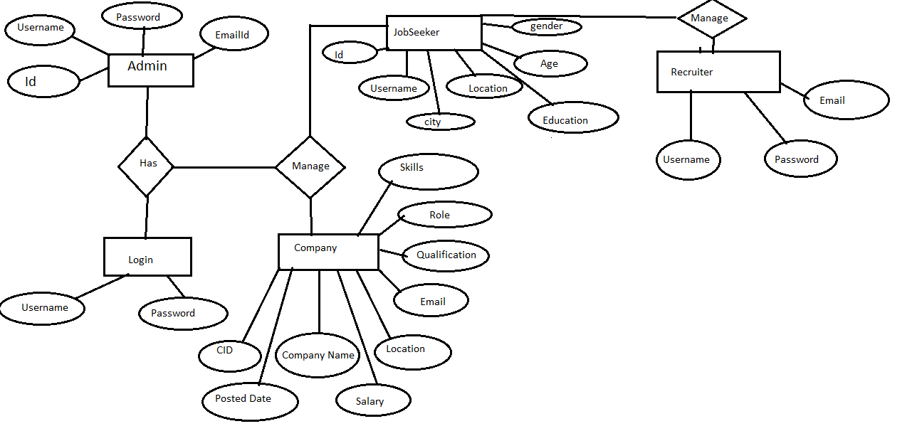
ER Diagram

Slide 15

Project Screenshots:

Slide 16
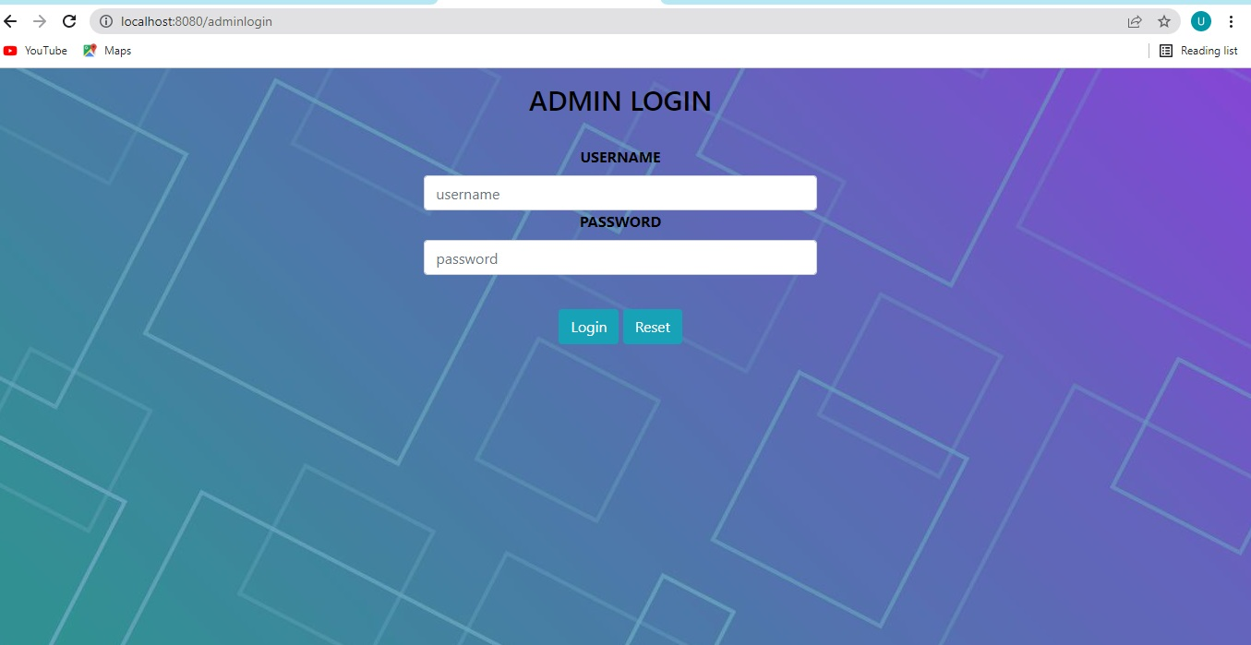
Admin Login:

Slide 17

Admin Home Page:

Slide 18

JobSeeker Home Page:

Slide 19
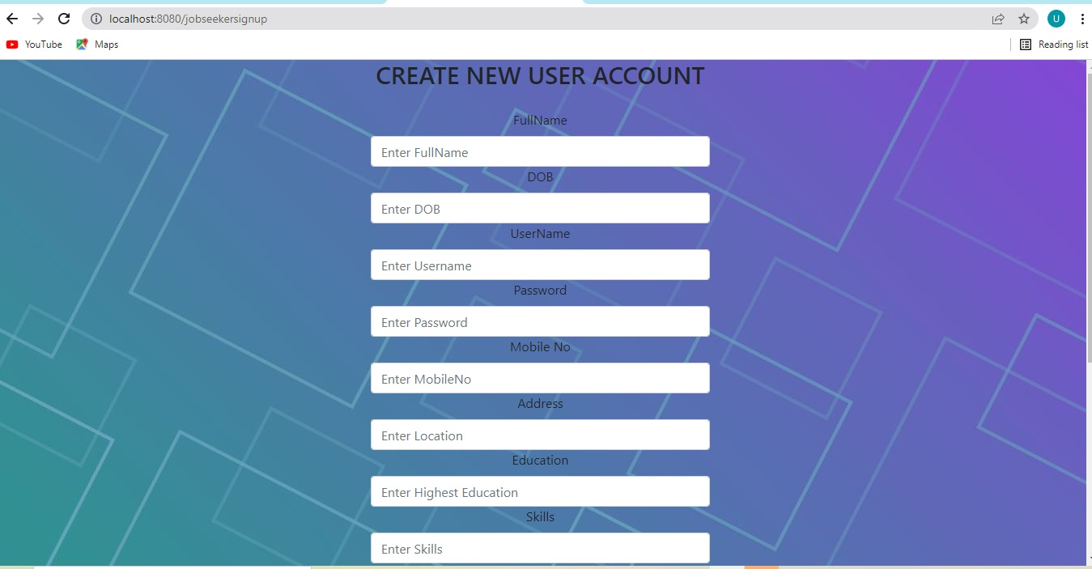
JobSeeker Registration:

Slide 20
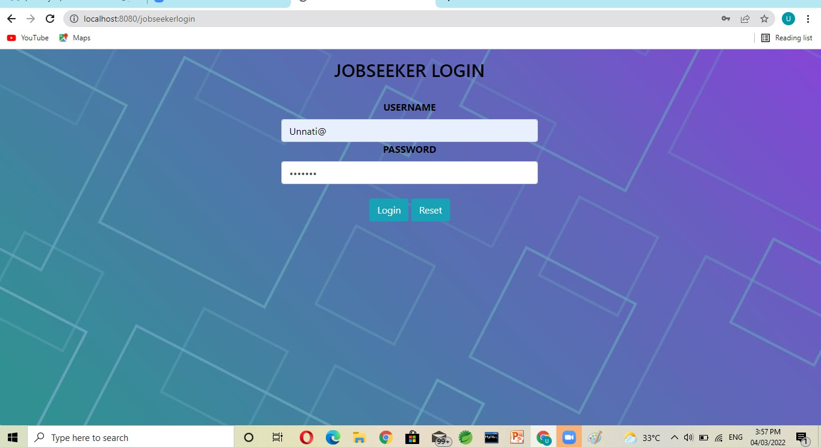
JobSeker Login

Slide 21
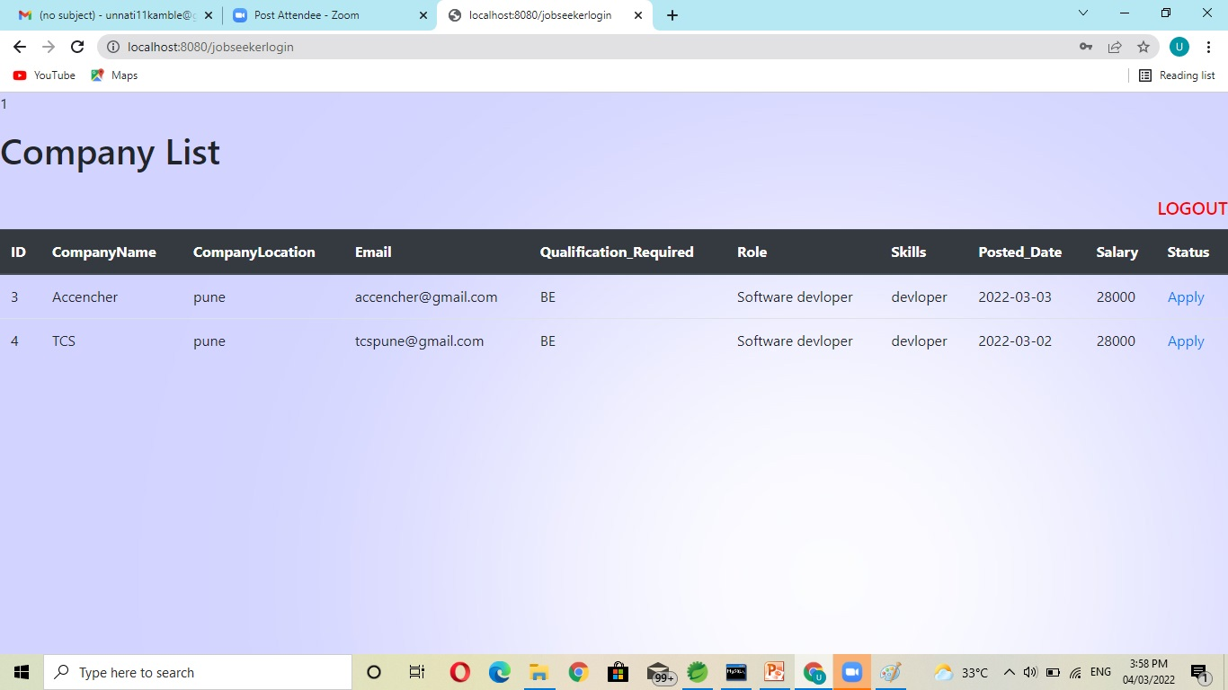
Company List:

Slide 22

Recruiter Home Page:

Slide 23
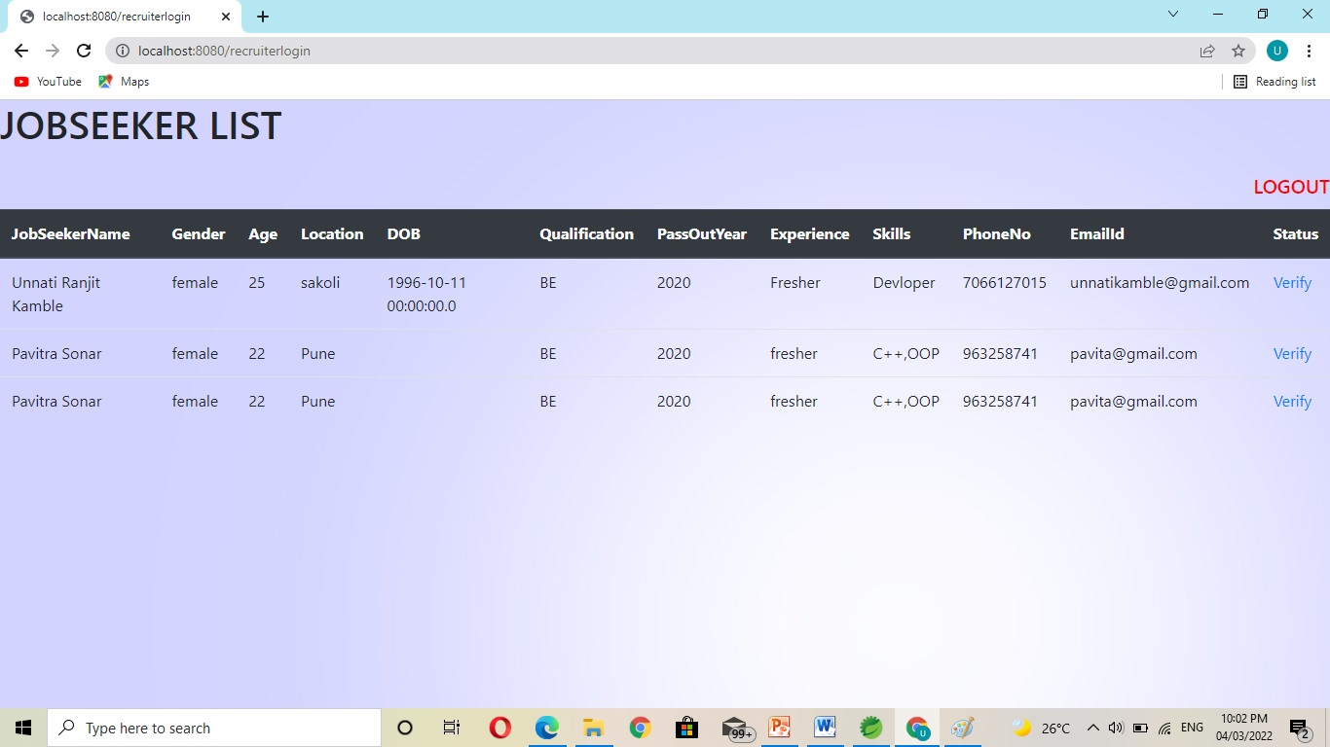
Verify JobSeeker:

Slide 24
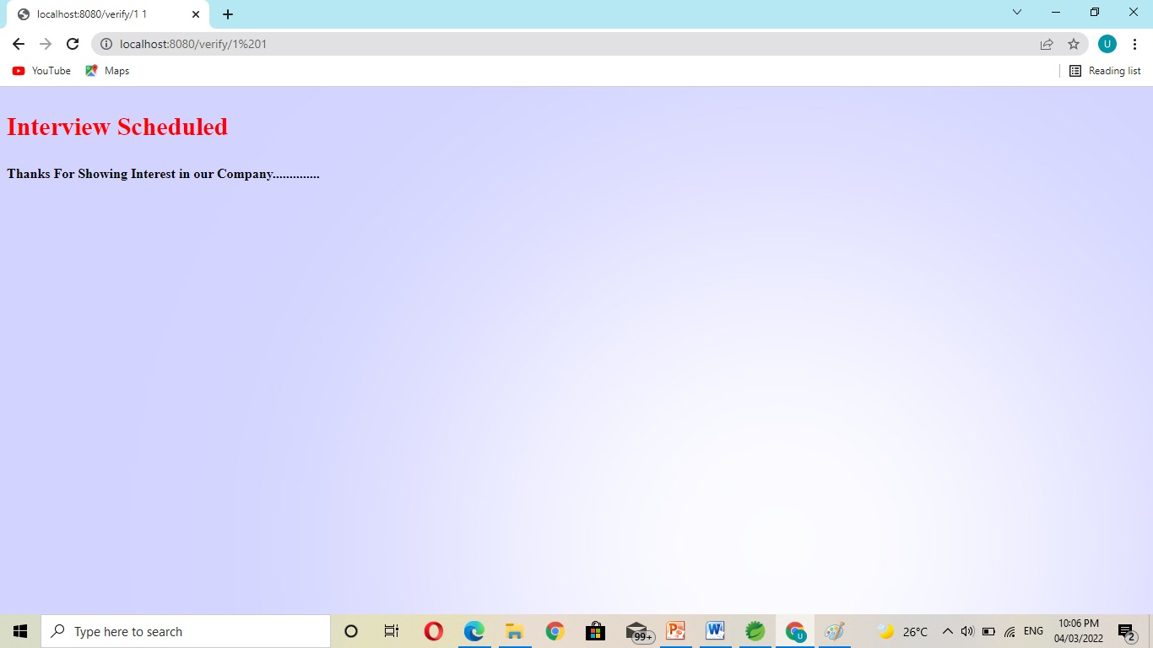

Slide 25
Conclusion:
It has the facility of maintaining the details of the joobseeker, thereby reducing the manual work. It will save time and energy which are searching jobs in newspaper or news . Placement Management System can be accessed throughout the jobseeker with proper login provided.

